Slide 1


《蓉城主阵地》2024-2025学年英语
七年级上册
Starter Unit 1

Slide 2

STARTER
UNIT 1
SECTION B
1a-1b
看读课

Slide 3
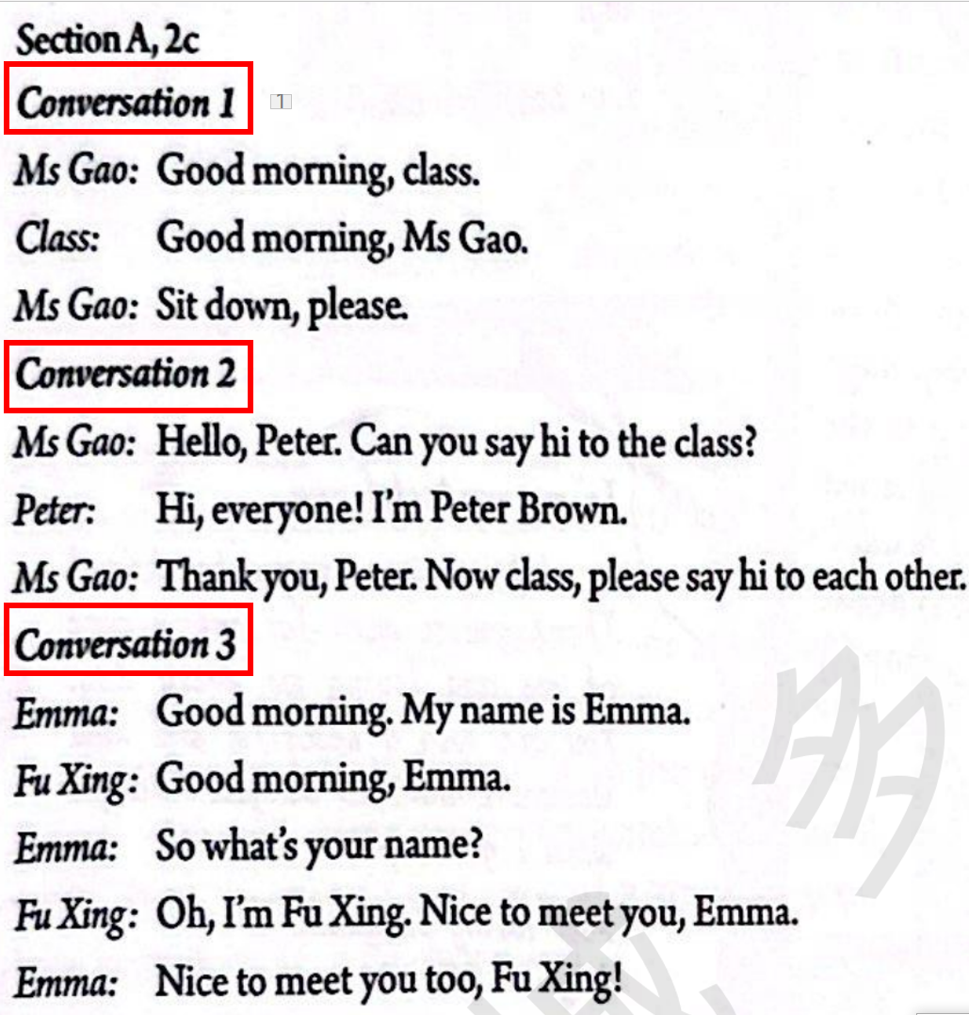
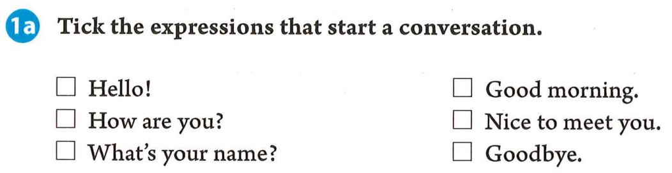
SECTION B
How do you start a conversation?
/ɑː/
/eɪ/
(√)
How many expressions?
Let’s share your homework！缩略词ABC、图标、键盘、数学字母符号
“√”出用来开启一段对话的表达。
It’s not polite!

Slide 4


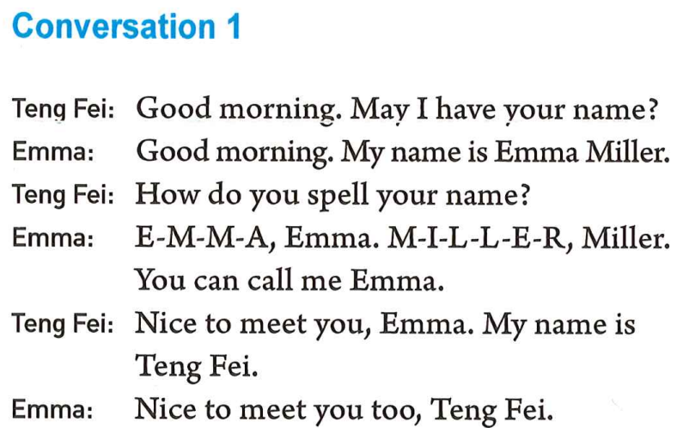
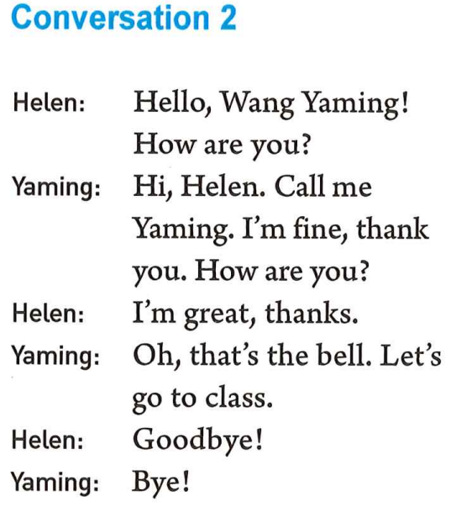
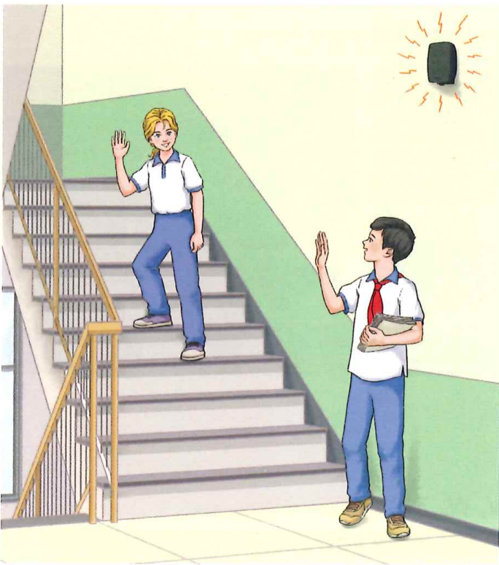
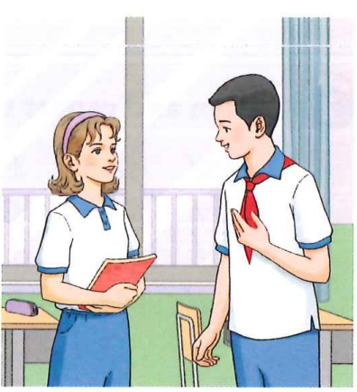
读对话。找出人们是怎样开启他们的对话的。
1.How many conversations are here?
2.Who are talking in the conversations?
in the pictures?
Helen
Emma
Teng Fei
Yaming
How are you?
？
May I have your name?

Slide 5
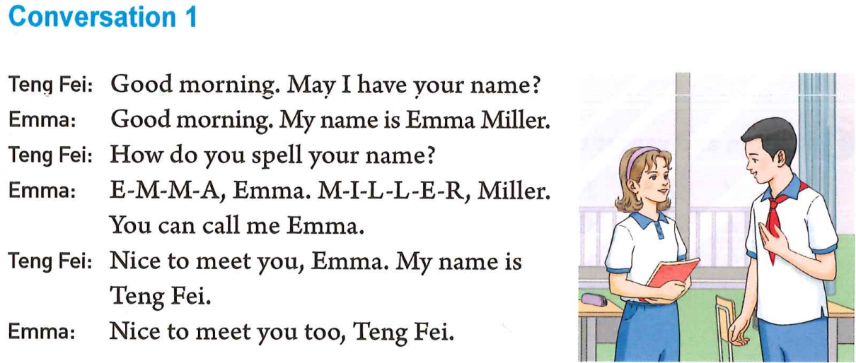
1.Where are they?
They are in the classroom.
So, what’s your name?
2.Do they know each other?
What’s the difference?
No, they don’t.
3.What else does he want
to know about her name?
/e/
The spelling of her name.
4. What’s Emma’s response?
End the conversation.

Slide 6
It’s time to go to class.
1. Where are they?
They are in the staircase.
2.Does Helen know Wang Yaming?
Yes, she does.
3. What can we call Wang Yaming?
We can call him Yaming.
4. Are they classmates?
/e/
No, they aren’t.
They are schoolmates.
5. How do they end the conversation?

Slide 7
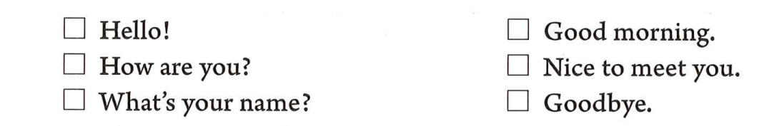
√
√
√
？
two ways to start a conversation
meet for the first time
know each other
Hello!
Hi!
I’m…
My name’s…
What’s your name?
Good morning.
How are you?
Good afternoon.
May I have your name?
end the conversation
Nice to meet you.
Goodbye.
response
Nice to meet you too.
Bye.

Slide 8
Homework
Must do:
1.跟课本录音朗读1b对话。注意朗读时要流畅，学着模仿语音与语调。
2.总结并写下start a conversation 和end the conversation的各种方式。
3.运用实践作业
运用本课所学语言主动问候老朋友，结识新朋友。
Try to do:
1.去认识你所在年级的至少三个老师，写下其中一组对话。
2.给本单元场景图排序，讲明排序的原因。

Slide 9


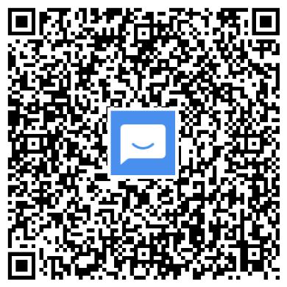
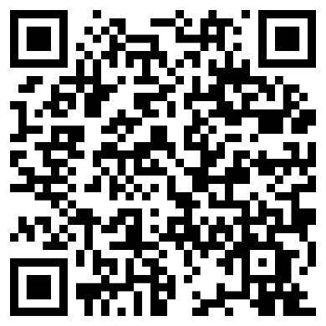
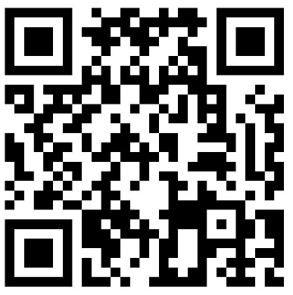
©本课件著作权属成都领航教材教法研究工作室.学程先锋所有，受《中华人民共和国著作权法》保护。除法律另有强制性规定外，未经成都领航教材教法研究工作室.学程先锋的特别书面许可,任何单位或个人不得以任何方式非法地使用本课件内容，不得私自转发给超越授权使用范围的第三方，不得将本课件用于任何商业用途。若需商用或取得课件的全部内容，请联系：028-87323348。
入群获取全套教学课件： | 扫码查看2024版电子样书： | 扫码领取2024版纸质样书：
联系电话：028-87323348

